Slide 1
Application of Artificial Neural Networks in Handwritten Text Processing
Designing the Amazing Handwriting Interpreter

Slide 2
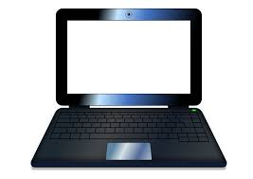
keyboard
touchpad
Introduction
The current standard of text input into the typical personal computer involves usage of an alphanumerical keyboard. However, speed and efficiency with the keyboard are severely limited without extensive user practice. Other restrictions often include having to constantly look at the keys being pressed. However, text input can be improved through utilization of the touchpad, which relies only on a user’s handwriting ability, an almost universal skill in the modern day.

Slide 3
Resources
Python 3.4.4
Anaconda 2.3.0 (64-bit) distribution
Anaconda Accelerate from Continuum Analytics, featuring NumPy optimizations
MNIST handwritten digit dataset: A set of 28px by 28px images representing handwritten digits 0-9; 50k total images for training and 10k images for testing.
Background
Feedforward neural networks are a subclass of machine learning inspired by neural connections in the brain. They are comprised of nodes, or neurons, organized in layers. A node “fires”, or sends out a 1, if its respective weighted input is above a certain threshold. In this way, the input is fed forward through the network, hence its name.
Numerical data is entered into the input layer, through one or more “hidden” layers, and after a series of calculations a vector is output from the output layer used for classification.

Slide 4
Project Goals
To design an application that interprets handwritten digits input through a laptop touchpad. The application’s graphical user interface will display the drawn image and the interpreted text in a text field. It will also have other basic features of a text processor.
To achieve a classification accuracy of 95% on a test set of digits generated by simulating typical usage of the application.
Further Research
To further improve accuracy, I can experiment with other techniques:
Standardizing image position with center of mass instead of center of bounding box
Implementing more complex neural network topologies
More data
Artificial expansion by including distortions, stretching and squeezing, and skewing
Once consistency with numerical digits is achieved, the application can be generalized to alphabetical characters with (you guessed it!) more data!

Slide 5
Improving Accuracy
Error Analysis
The biggest improvements in accuracy of classification by the neural network came with manipulation of the data itself. Standardizing the images input into the GUI and generating translations of the MNIST training data both increased accuracy significantly.
Interestingly, training the neural network on images input through the GUI, images designed to closely represent future field data, did not improve accuracy, testing 30% lower than the best network trained purely on MNIST images. Although adjusting the leaning rate of the network caused slight improvements, this network peaked at under 60% (see graph below).
The culmination of improvements achieved 85% accuracy, just short of the 95% goal.

Slide 6
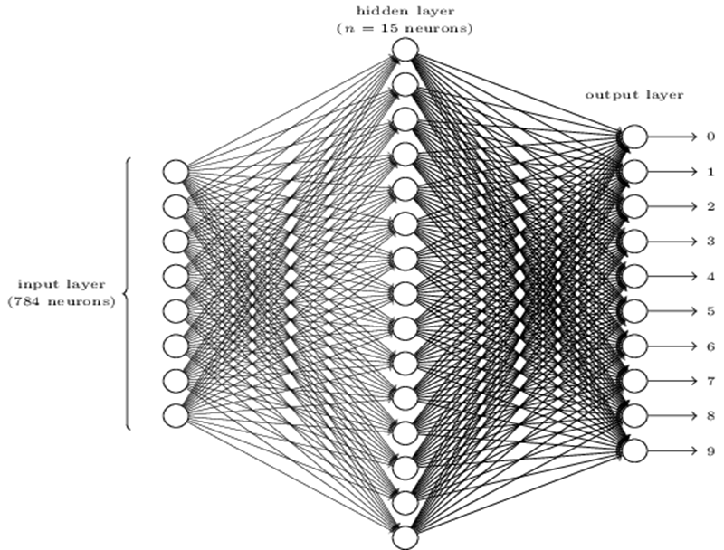

Slide 7
Conclusion
Although the secondary goal of 95% accuracy was not achieved, the primary goal of creating a simple but functional application for text processing through use of the touchpad was accomplished.
The application can display text and supports functionality such as loading and saving files as well as copying and pasting text. It also supports the classical method of keyboard text input.
This application provides a useful alternative to the awkward and sometimes inefficient keyboard. Through further research such as that listed below, this program may become much more accurate and practical.
Bibliography
Hinton, Geoffrey E. et. al. “Learning Representations by Back-Propagating Errors.” Nature International Weekly Journal of Science. 9 October 1986.
LeCun, Yann and Bengio, Yoshua. “Pattern Recognition and Neural Networks.” in Arbib, M. A. (Eds), The Handbook of Brain Theory and Neural Networks, MIT Press, 1995.
Lecun, Yann et. al. “Gradient-Based Learning Applied to Document Recognition.” Proc. of the IEEE. November 1998.
Nielsen, Michael A. "Neural Networks and Deep Learning." Determination Press, 2015. Web. 13 March 2016.
Olah, Christopher. “Visualizing MNIST: An Exploration of Dimensionality Reduction.” Colah.github.io. Web. 13 March 2016

Slide 8
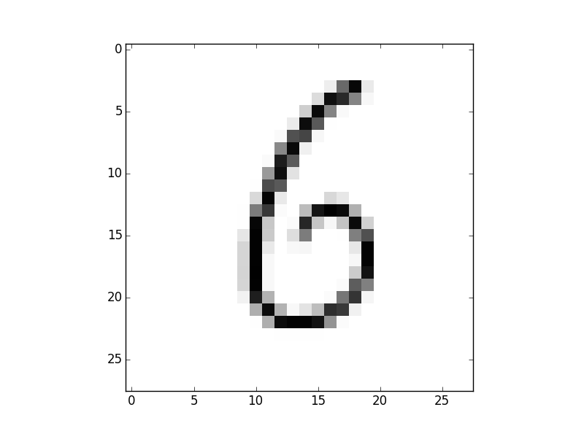
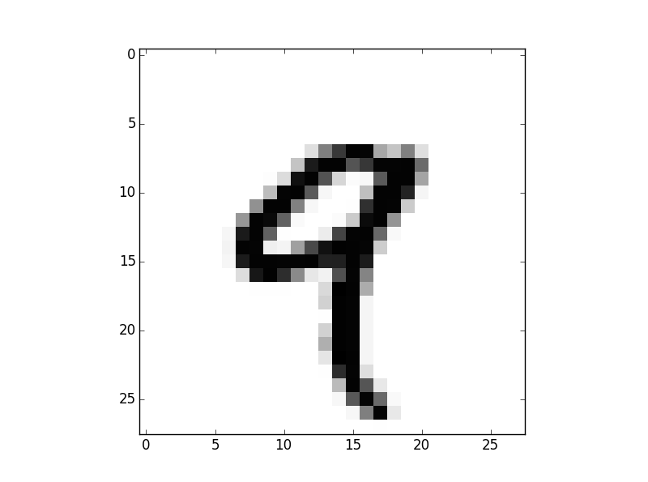
Sample MNIST Images
Sanjay Mohan
Los Gatos High School

Slide 9
The first method of improving accuracy involved artificially expanding the MNIST training data set. I supplemented the standard 50k training images with 200k images consisting of four 2 pixel translations, one in each cardinal direction, of each original training image.
I created my own set of 100 images, 10 per digit, for testing by drawing into the application as a typical user would. I artificially expanded this set to 500 total images by adding four translations, +/- 7° and +/- 15 °, of each original image.
Training with 250k Images with Translations
Accuracy (%)

Slide 10
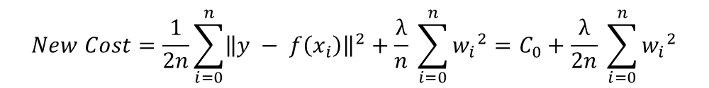
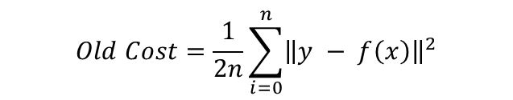
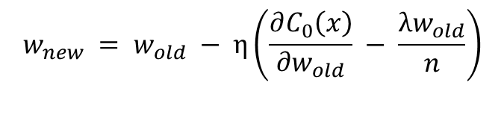
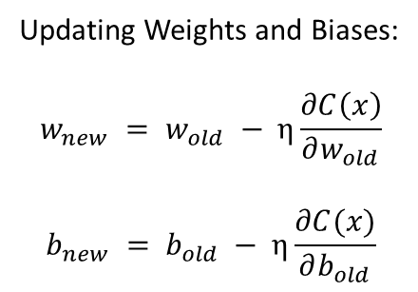
$$Old Cost=\frac{1}{2n}\sum_{i=0}^{n}{{\left\|y − f\left(x\right)\right\|}^{2}}$$
Updating Weights and Biases:
$$w_{new} = w_{old} − η\frac{∂C\left(x\right)}{\begin{aligned}∂w_{old}\end{aligned}}$$
$$b_{new} = b_{old} − η\frac{∂C(x)}{∂b_{old}}$$
L2 Regularization: keeps weights small by making large weights
increase the cost, thus increasing the change in weight update
$$New Cost=\frac{1}{2n}\sum_{i=0}^{n}{{\left\|y − f\left(x_{i}\right)\right\|}^{2}}+\frac{λ}{n} \sum_{i=0}^{n}{{w_{i}}^{2}}=C_{0}+\frac{λ}{2n} \sum_{i=0}^{n}{{w_{i}}^{2}}$$
$$w_{new} = w_{old} − η\left(\frac{∂C_{0}\left(x\right)}{\begin{aligned}∂w_{old}\end{aligned}} − \frac{λw_{old}}{n}\right)$$
Cost: How far off the network is in its prediction
Updating weights and biases: “learning,” ie improving classification

Slide 11
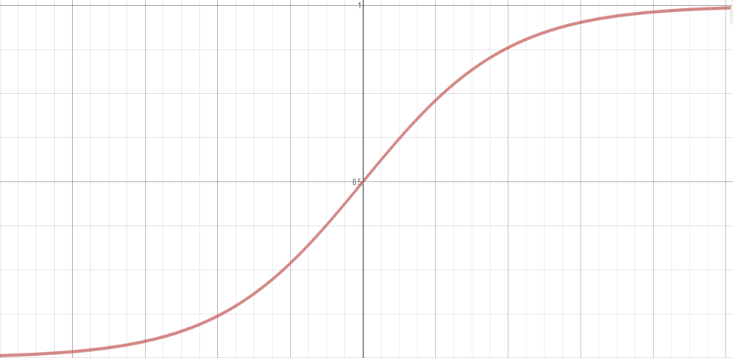
A node “fires” when weighted input is entered into $a\left(z\right)=\frac{1}{1+e^{−z}}$
1
Standardizing Input Images
-4 | -3 | -2 | -1 | 0 | 1 | 2 | 3 | 4 | 5
Old standardization algorithm aligns image to a
specific point and scales it up from a smaller size.
New algorithm centers bounding box of the
image and scales it down from a larger size.

Slide 12
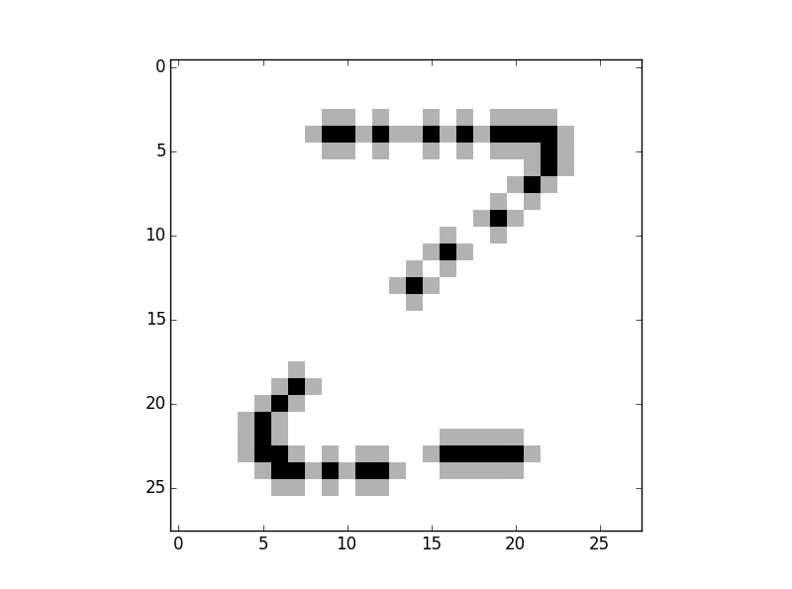
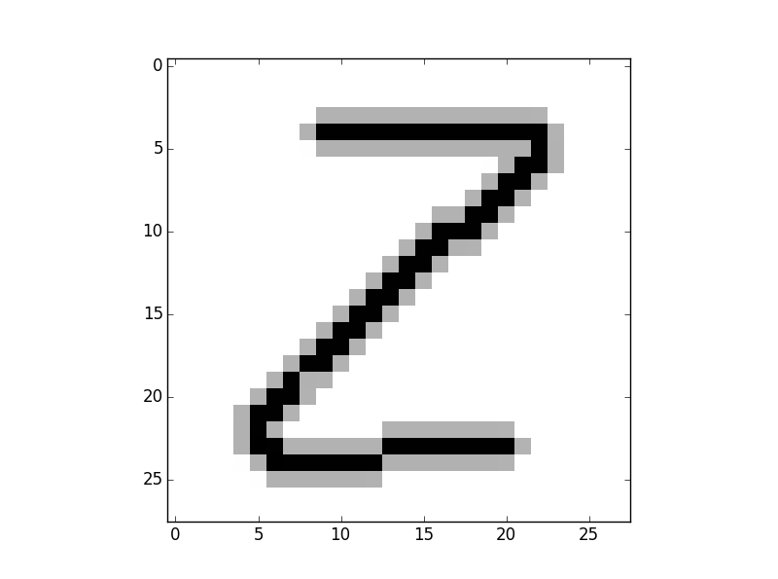
Old Point Recording
New Point Recording
Making GUI Data Capturing More Consistent
Improving “robustness,” or increasing accuracy on future data

Slide 13
Accuracy of Network That Was Trained On Own Training Images
Accuracy (%)
The built-in Python methods that capture mouse motion events are too slow and inconsistent, leading to inaccurate classification.

Slide 14
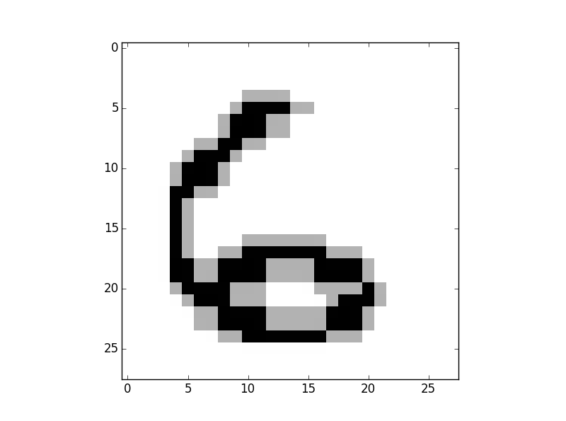
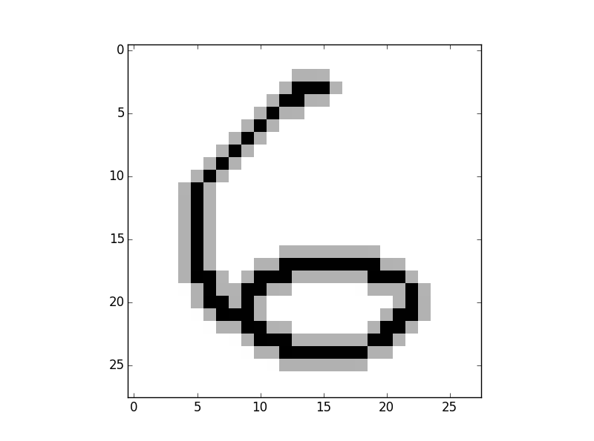
Improving the standardization algorithm makes images more consistent and similar to MNIST images, such that input images will be similar to the images on which the network was trained.
Old Standardizaton
New Standardizaton

Slide 15
Smaller Weight Initializations => Faster Learning
Sanjay Mohan
Los Gatos High School

